Slide 1
Content Management as Critical Success Factor for Personalized Medicine
Markus Kalkbrenner, Rudolf Koopmann
biologis Genetic Information Management GmbH - www.biologis.com

Slide 2

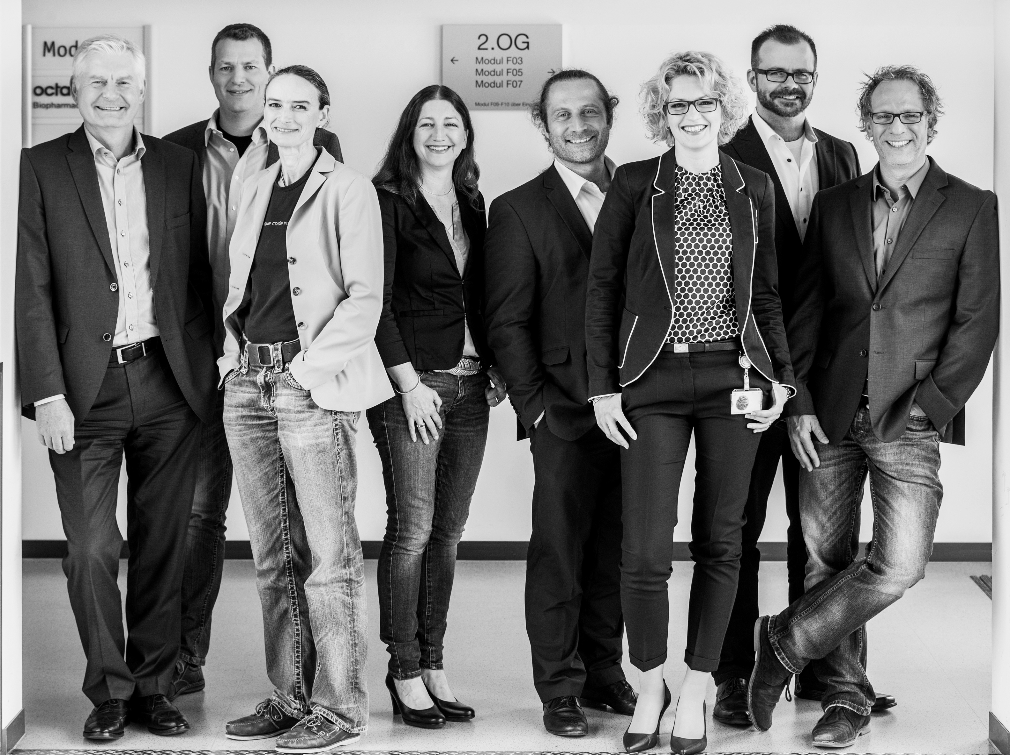
We are
30 highly qualified team players with background in
Software Development
Bioinformatics
Human Genetics
Our offer
Innovative IT solutions supporting genetic labs in translating genetic test results into clinical recommendations
Our Mission
Support and drive the adoption of
human genetic diagnostics into clinical practice

Slide 3
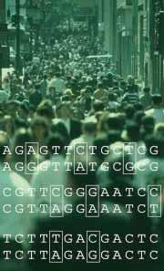
Pharmacogenetics
Finding the right drug and dosage for patients based on their individual genetic make-up
Most drugs are effective only in 25-60% of patients:
Spear BB et al. Trends Mol Med 2002;7:201-4.

Slide 4
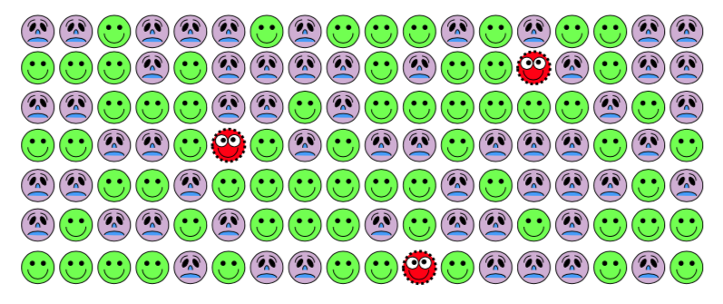
Mixed pool of responders and non-responders

Slide 5
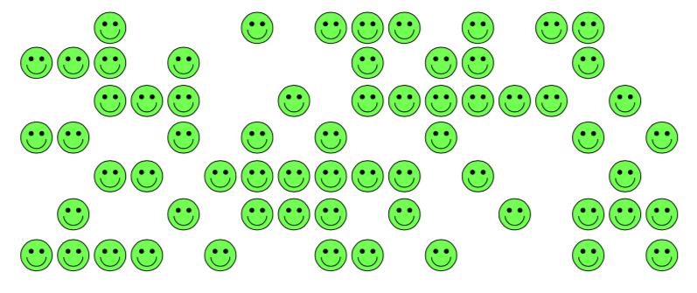
Responders benefit most – adjust therapy for the others

Slide 6
Genes determine the effectiveness and compatibility of medication
genes
A Absorbtion
D Distribution
M Metabolism
E Excretion
active ingredient
active ingredient
Concentration
genes
Cell
active ingredient
inefficient
6
genes
G- Protein
efficient
Rezeptor
adverse drug reaction
genes

Slide 7
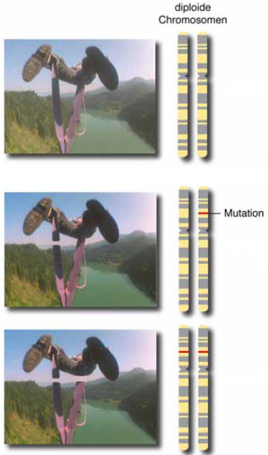
Possible consequences of genetic variants
efficient
compatible
partially efficient
problematic
inefficient
incompatible
Abb.: Prof. Dr. Theodor Dingermann

Slide 8
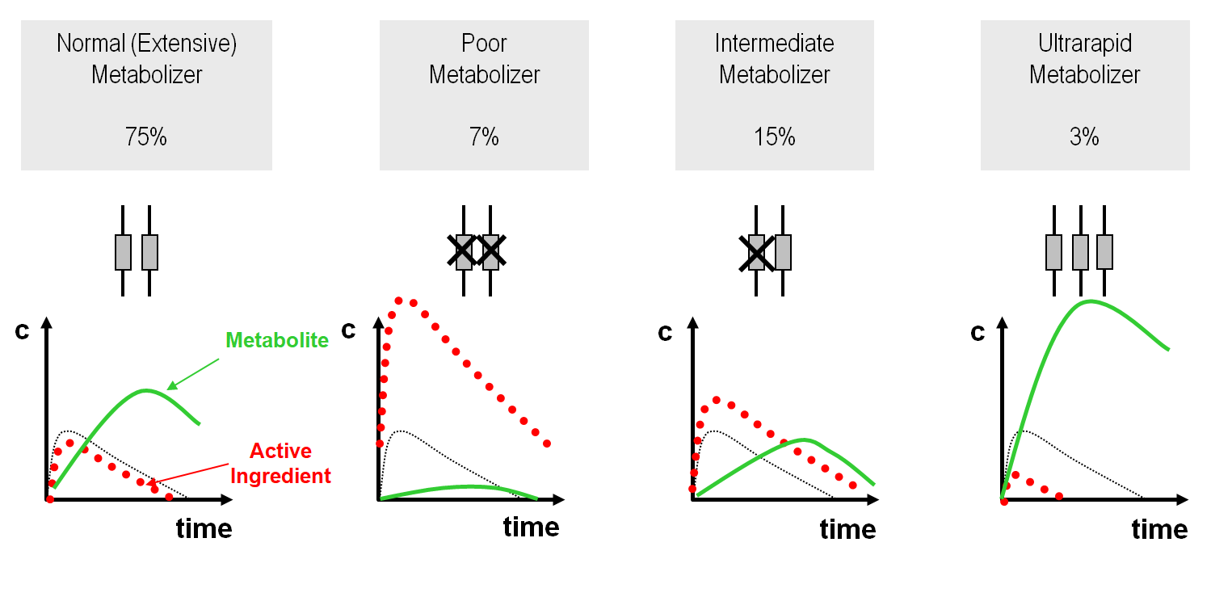
Pharmakogenetic – Metabolization of drugs
Pharmacogenetic metabolization of drugs
Abb.: Prof. Dr. Ivar Roots

Slide 9
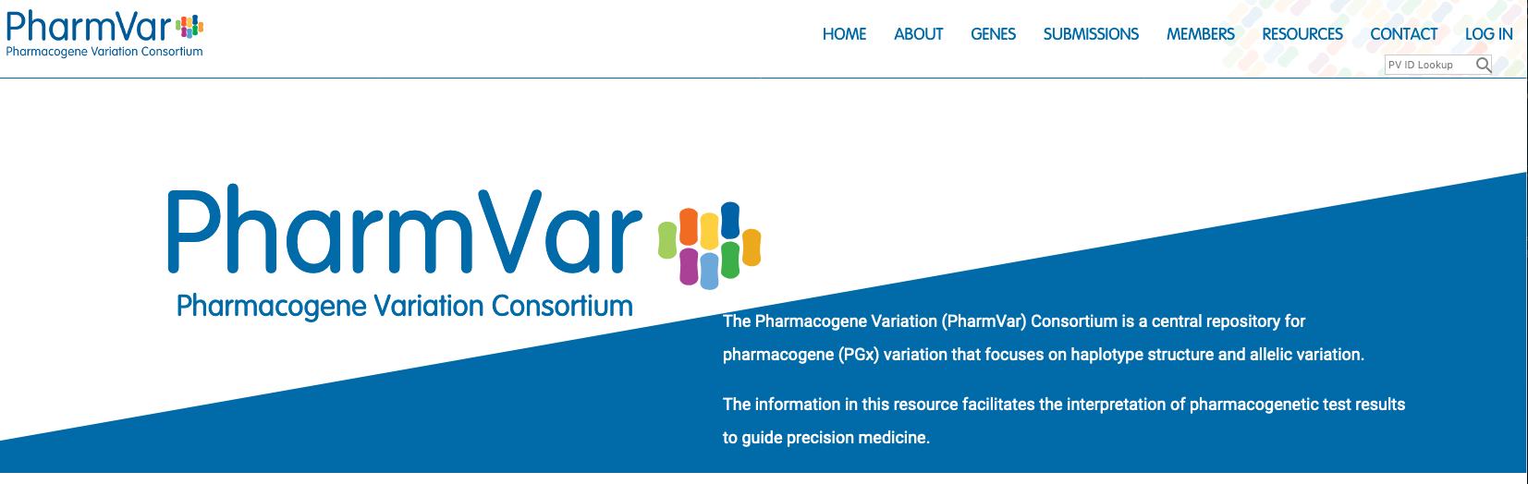
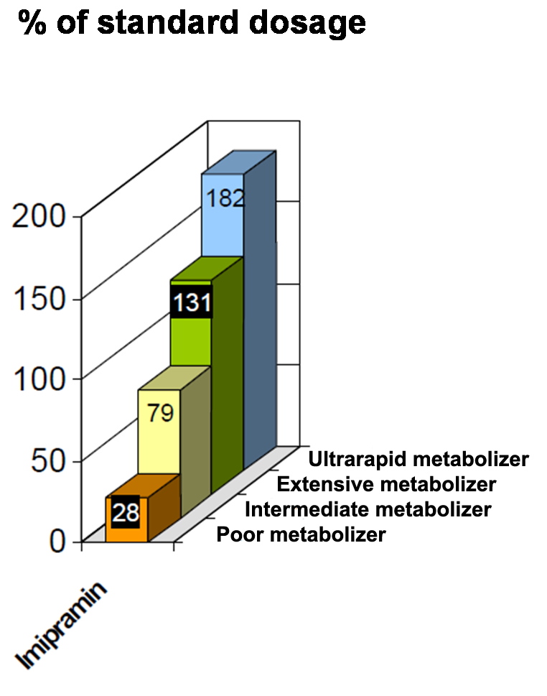
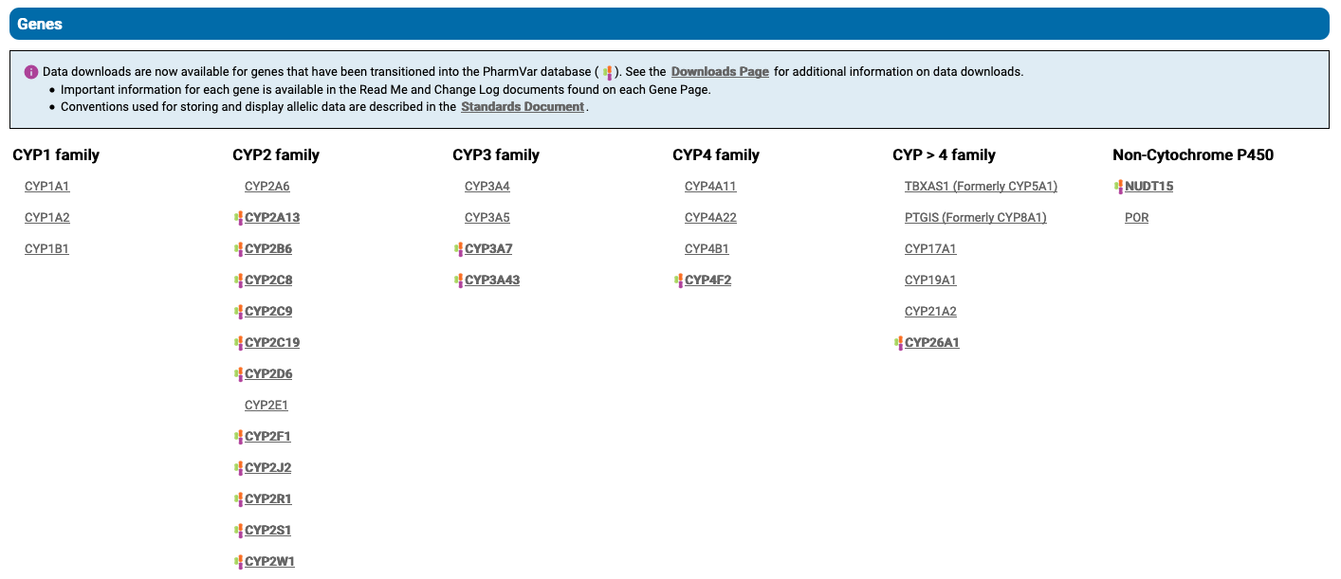
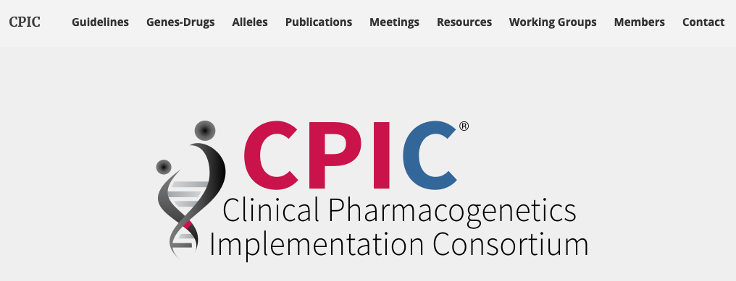

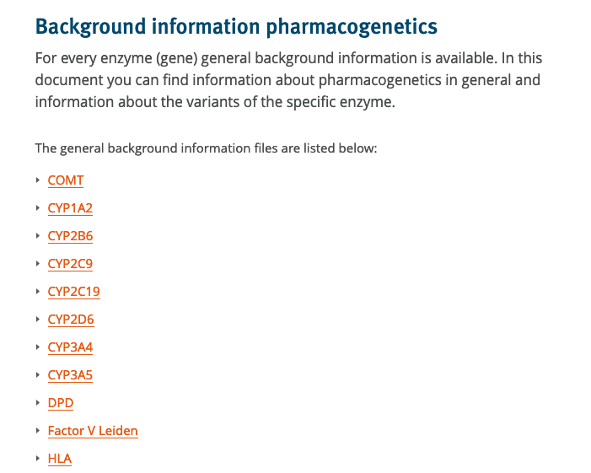
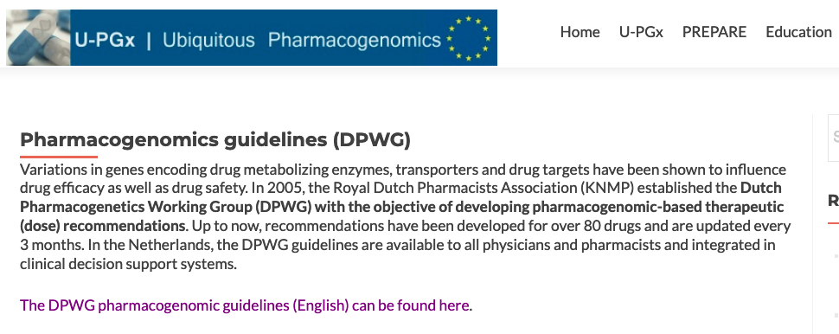
Pharmakogenetic – Metabolization of drugs
Genotype-based dosing guidelines

Slide 10
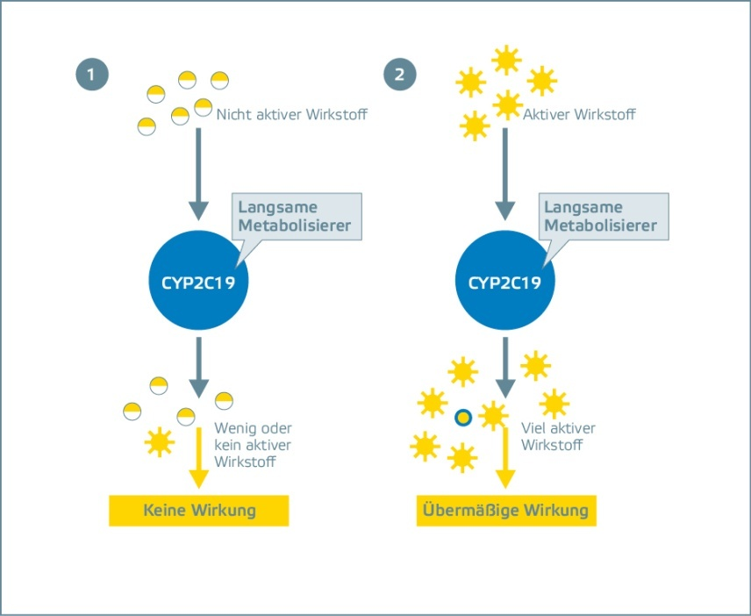

Translation of results into usable information
!
The genetic analysis indicates that you have a certain variant in your CYP2C19-Gene which apparently makes you a Poor Metabolizer for Clopidogrel

Slide 11
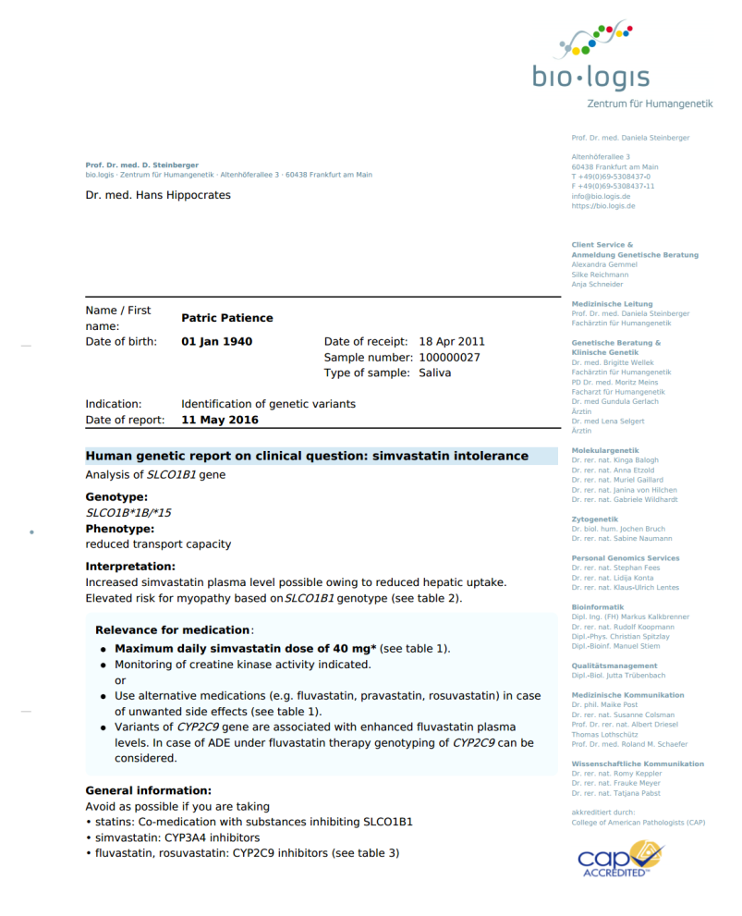
Translation of results into usable information
!
The genetic analysis indicates that Clopidogrel does not work for you. I will prescribe Prasugrel instead.

Slide 12
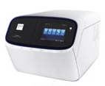
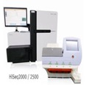
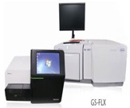
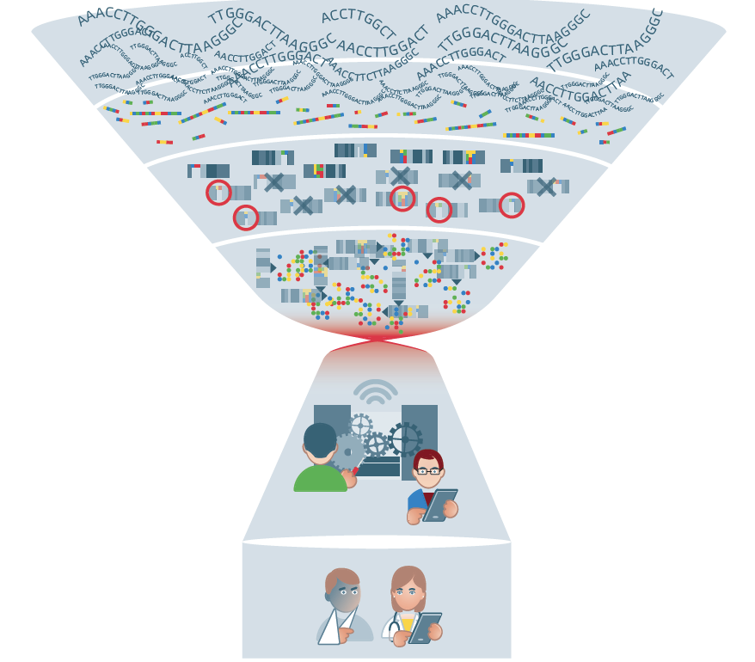
The interpretation and reporting bottleneck
Data production and processing
Interpretation and report production
Clinical application

Slide 13


Clinical decision support system
"Clinical decision support systems link health observations with health knowledge to influence health choices by clinicians for improved health care“ (Robert Hayward/wikipedia.org)
Content Management
Multilingual
(Approval) Workflows
Integration into Lab-/Hospital Information Systems
Data Aggregation
Rule Engine
Ontologies/Graphs
+

Slide 14







EU-funded project within the Horizon 2020 program
Aiming to support implementation of pharmacogenomics in clinical practice
bio.logis GIM responsible for implementing GIMS at 7 selected hospitals across Europe

Slide 15

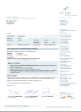

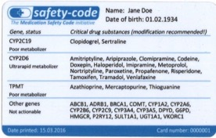




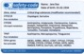

Dosing recommendations
for: 76 drugs based on: 44 variants
in: 12 genes
available: 7 languages
Project Sites
Leiden
Liverpool
Vienna
Aviano
Granada
Patras
Ljubljana
Patients
Notes:
Automated digital
PGx-Reports + Safety Card
in local language
for production @lab

Slide 16


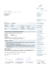
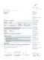




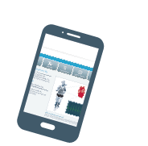






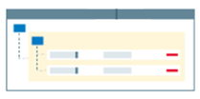
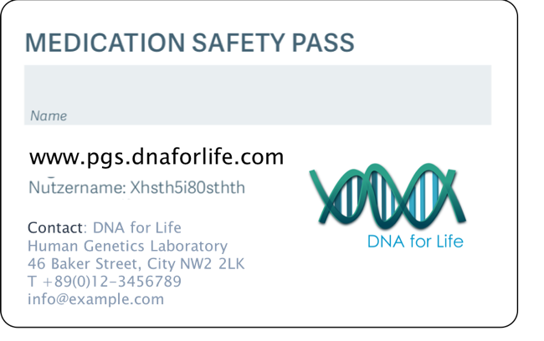


GIMS.pharma
PGx Laboratory
Referring
Physicians
Referring
Physicians
Genotyping Platform
LIMS / HIS
Genotypes
Patient Data
(anonymized)
PGx Report
Webportal
Genetic Report Engine
Mobile App
Official dosing recommendations
Medication Safety Pass
Content
Management
System

Slide 17
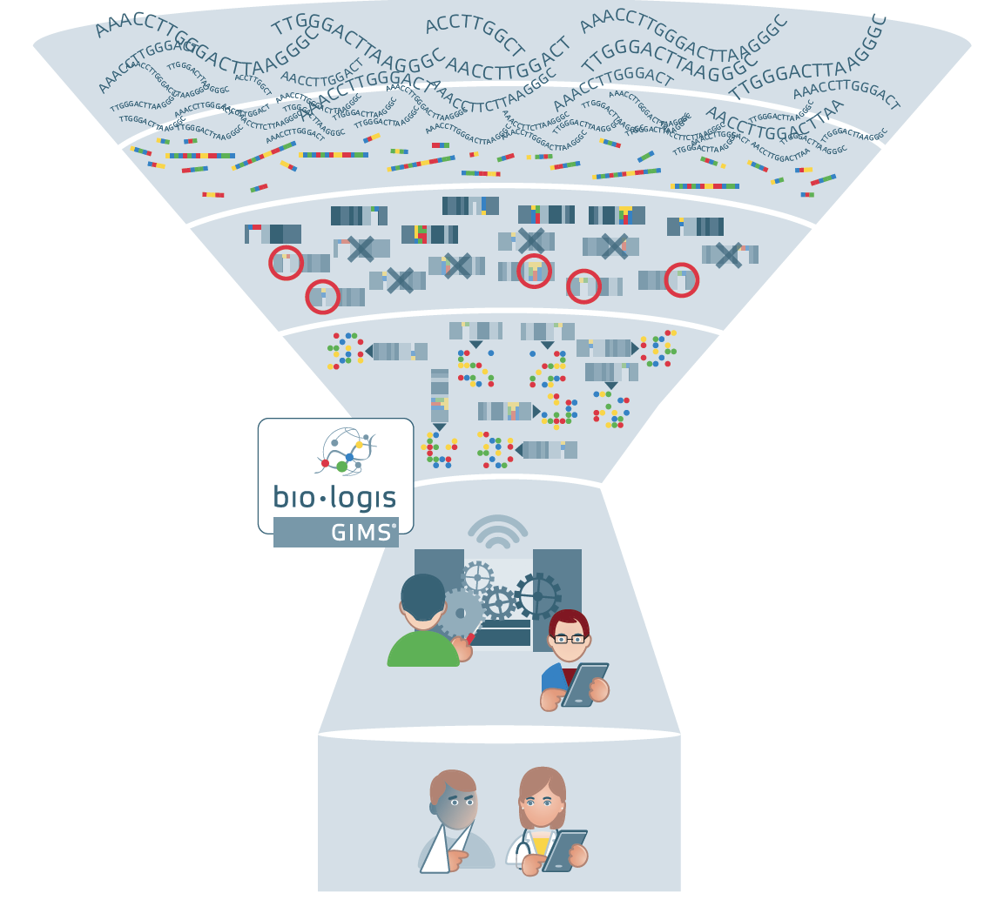
The interpretation and reporting bottleneck
Data production and processing
Interpretation and report production
Clinical application

Slide 18
GIMS.pharma
Turn-key, end-to-end solution for PGx
Comprehensive workflow solution for Pharmacogenomic Diagnostics
Features:
Diagnostic Report Module
Includes ready-to-use content, provided by The Royal Dutch Pharmacists Association - validated and used in the European U-PGx project (http://upgx.eu/)
Allows automated production of PGx reports including validated dosing recommendations
Report Layout Engine
Provides complete reports in ODT or PDF format based on client´s templates
Delivery Module
Allows labs to provide results through digital channels
Branded web-portal, mobile app and / or Medication Safety Pass with barcode
Direct interfaces to genotyping platforms, LIMS, HIS, etc.

Slide 19




Modules
Standardized DX report production
efficient management of clinical content
automated production of diagnostic reports
GIMS.DRM
certified as medical device
Smart and secure access to results and insights
delivery and clinically functional presentation of results via web-based applications
GIMS.DM
Curation of decisions for interpretations
structured documentation of variant annotation
sharing of arguments, decisions, clinical insights and other report content
GIMS.KMM

Slide 20
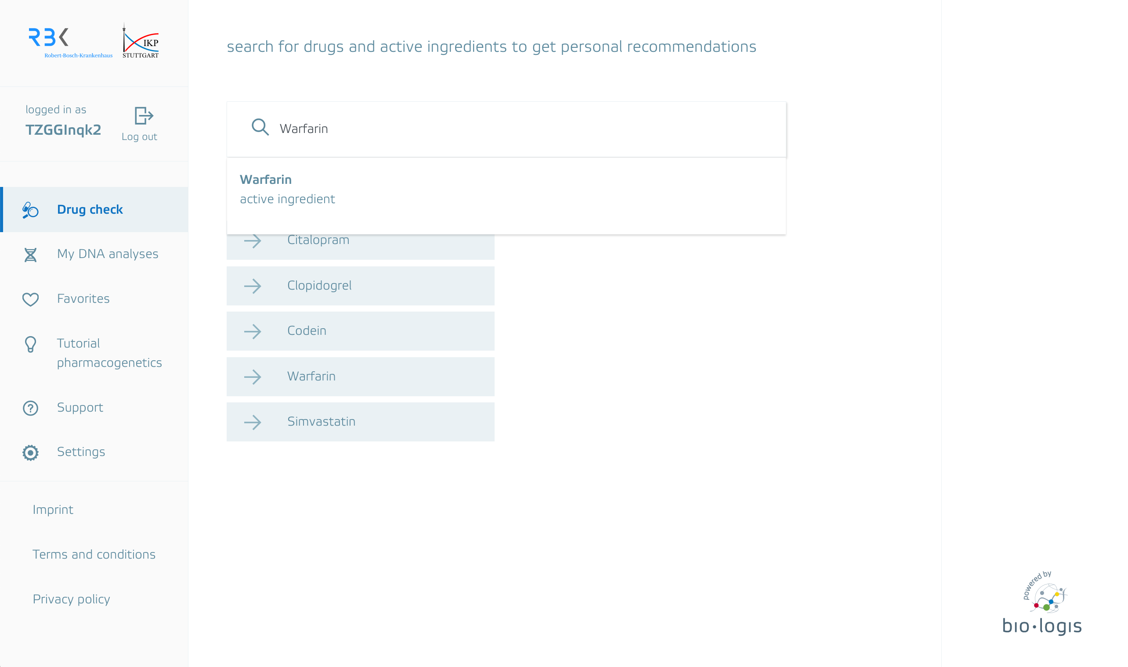
Genetic Health Record

Slide 21
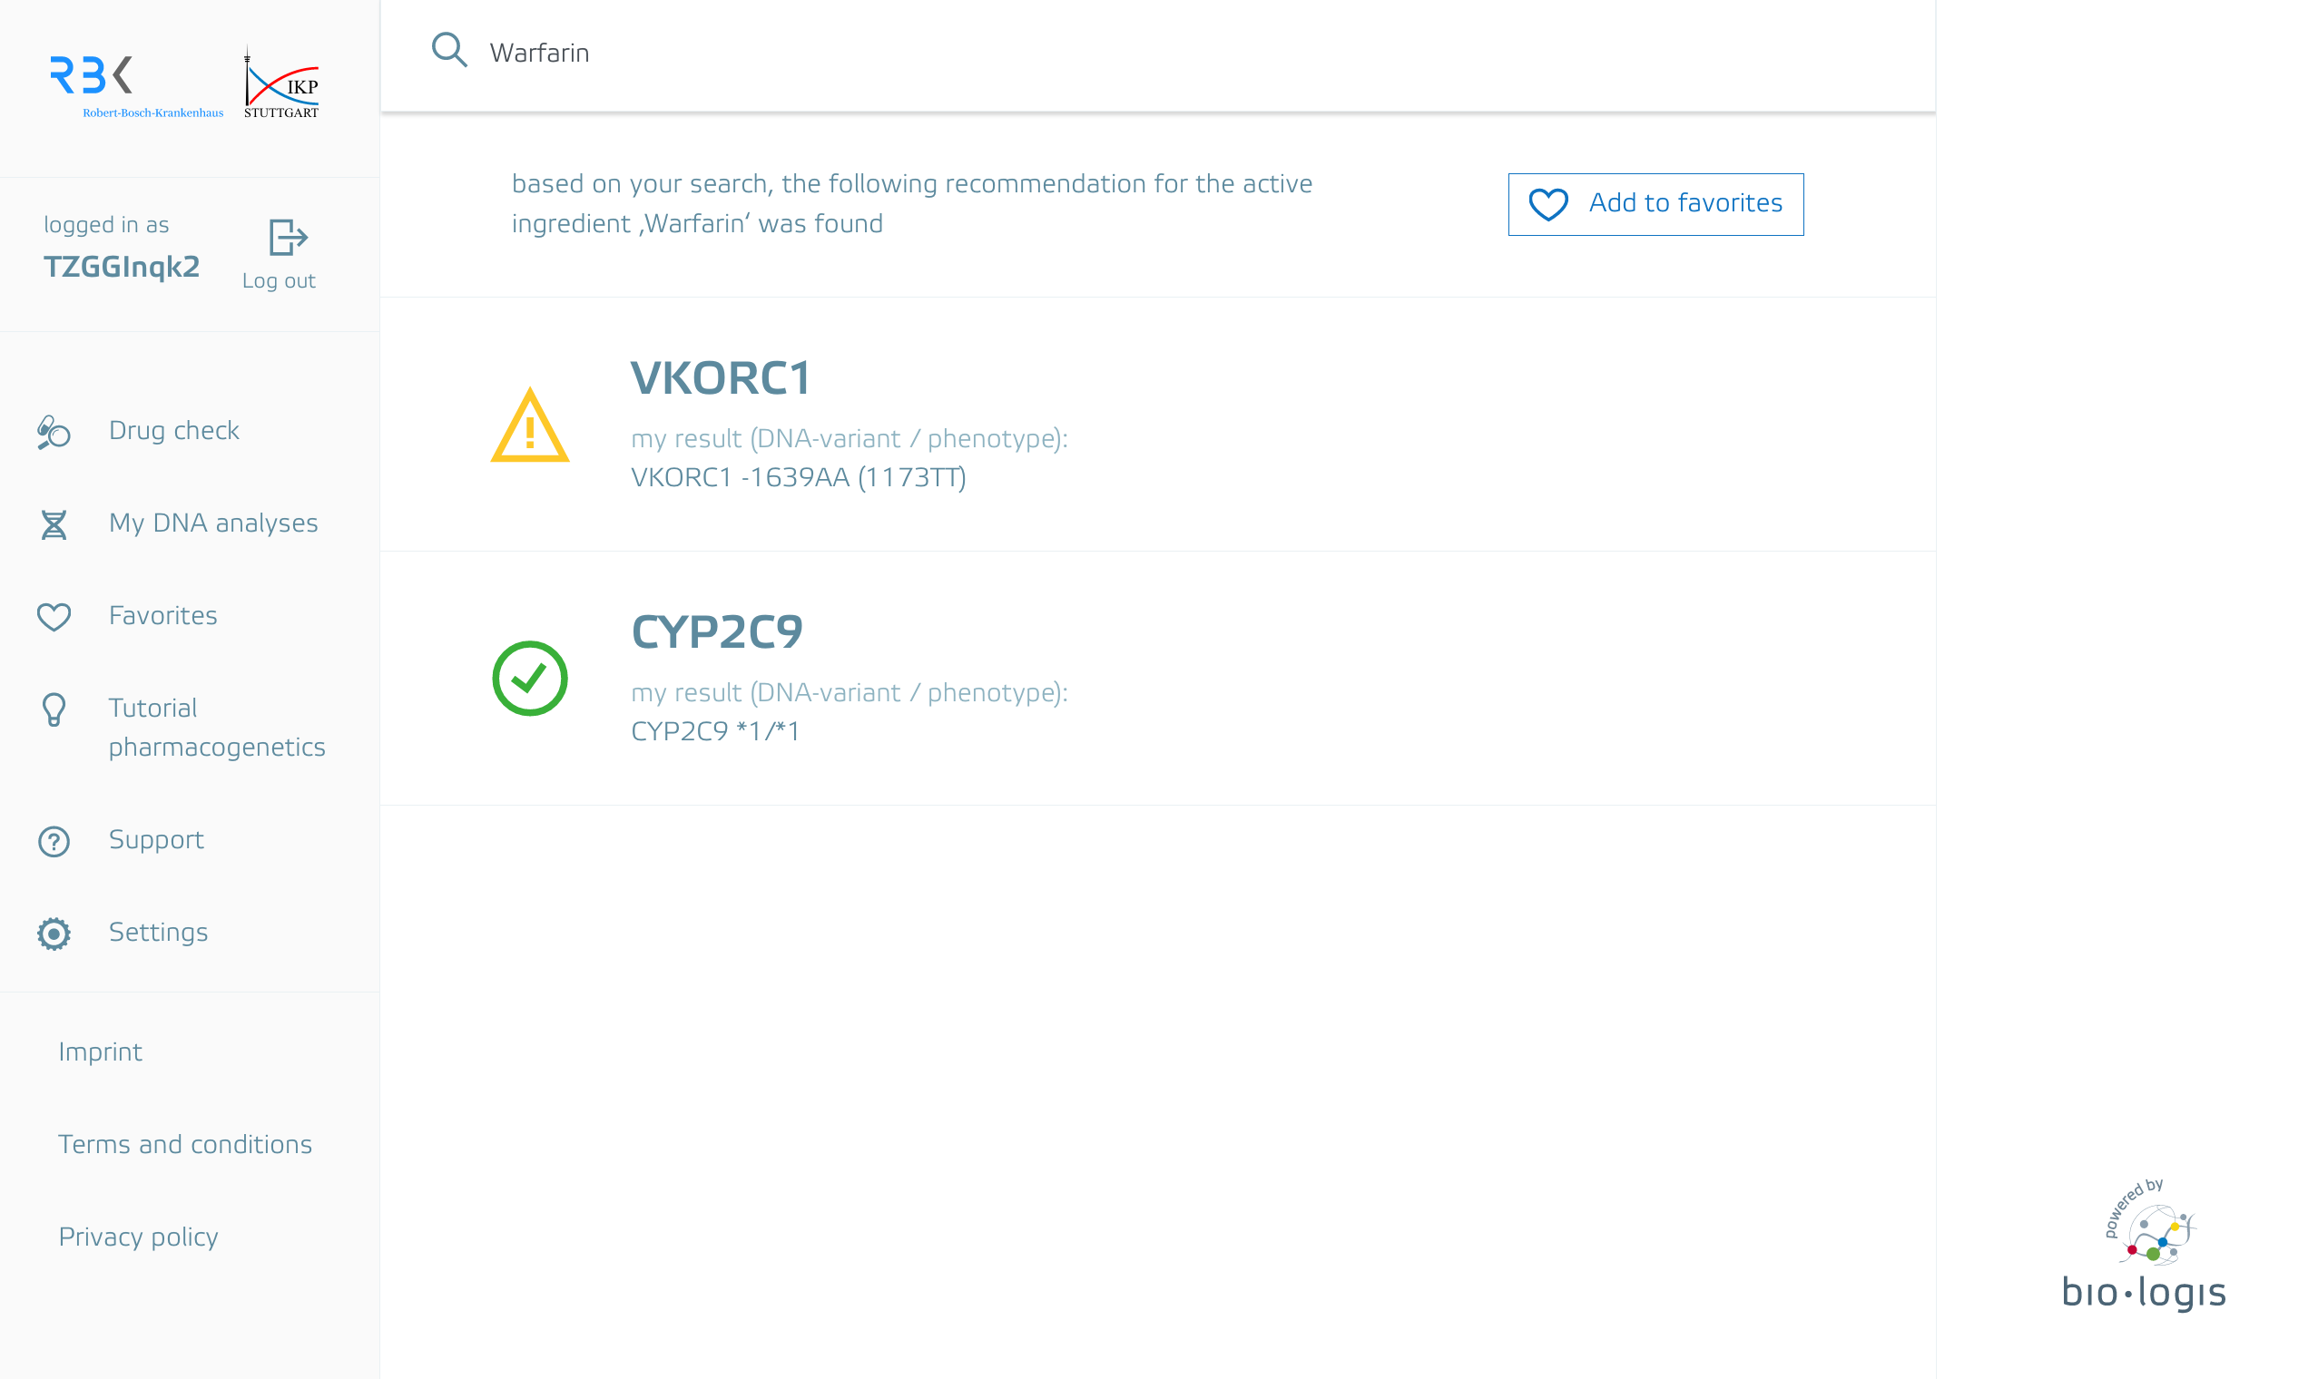
Genetic Health Record

Slide 22
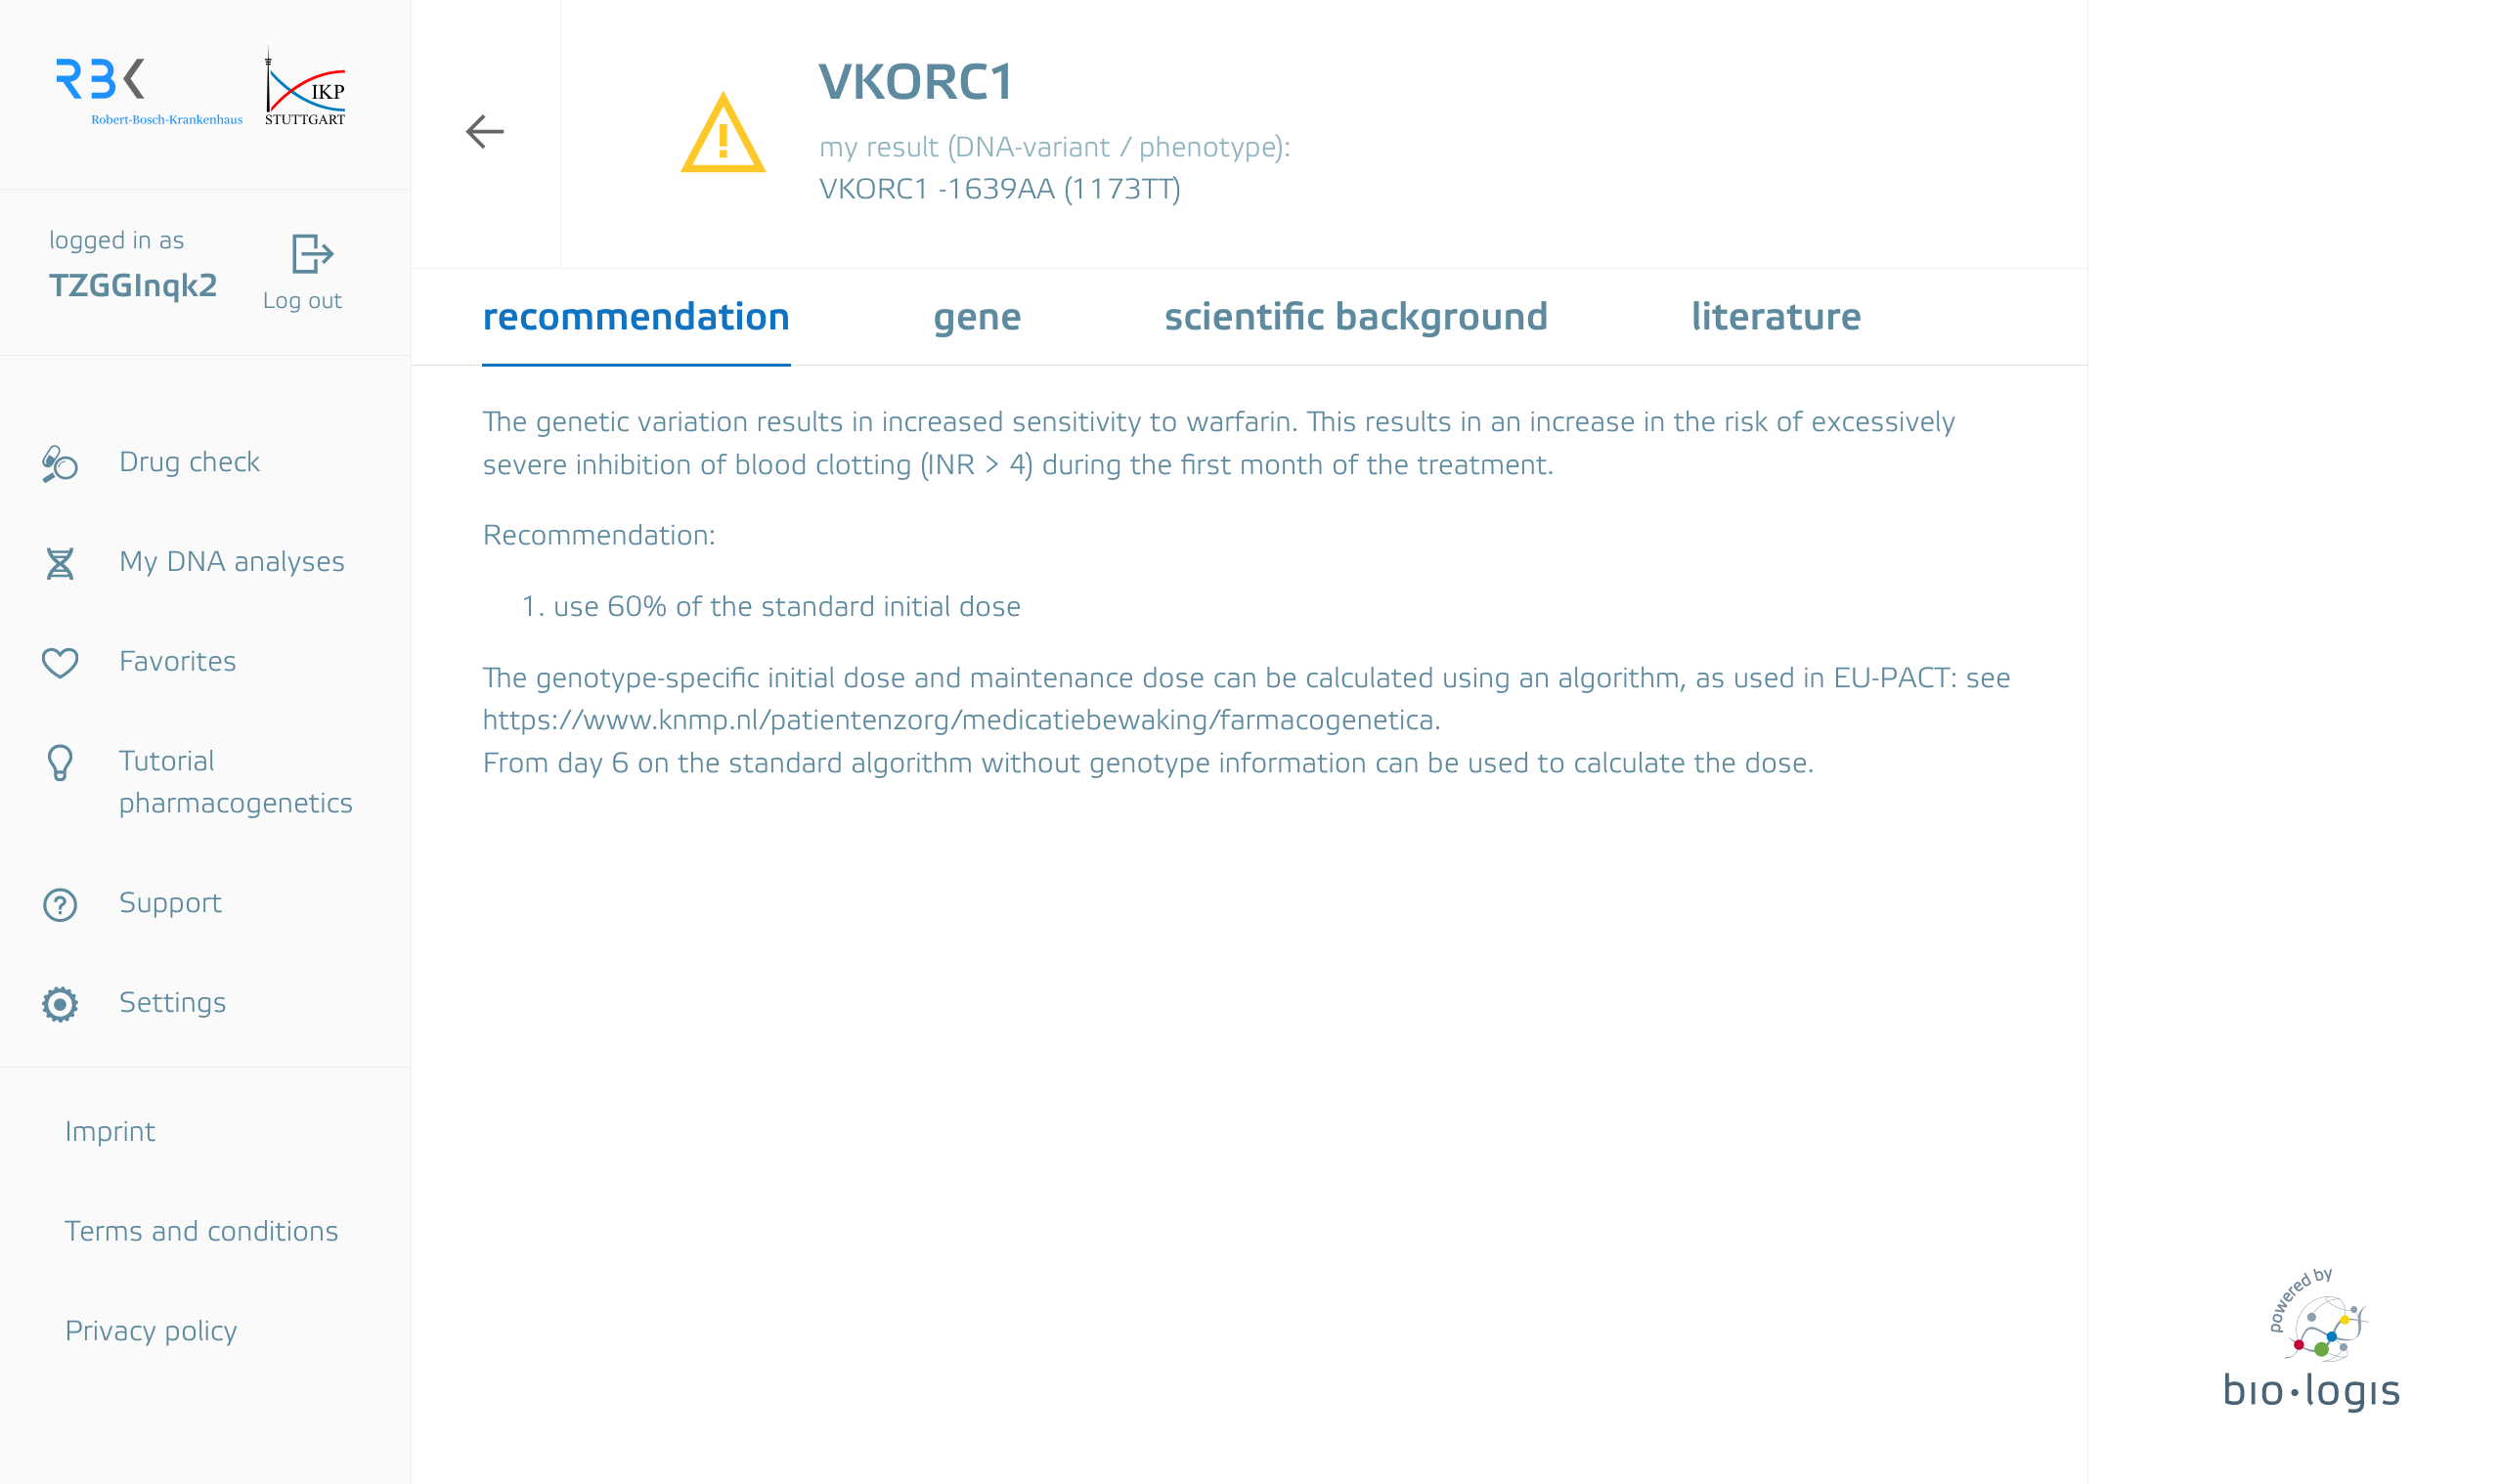
Genetic Health Record

Slide 23
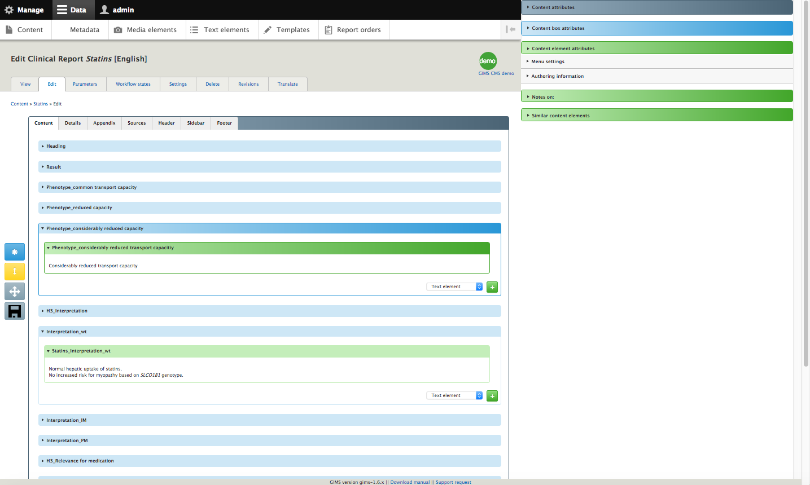
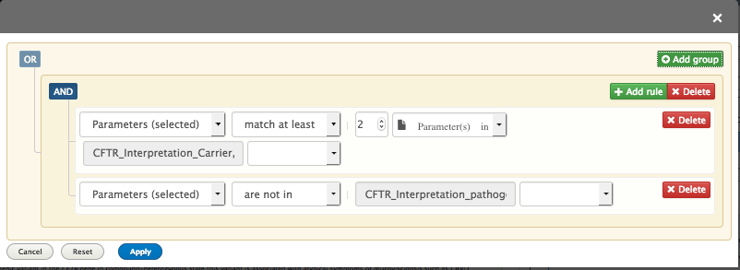
Sophisticated content management system
Allows complex rule combinations

Slide 24
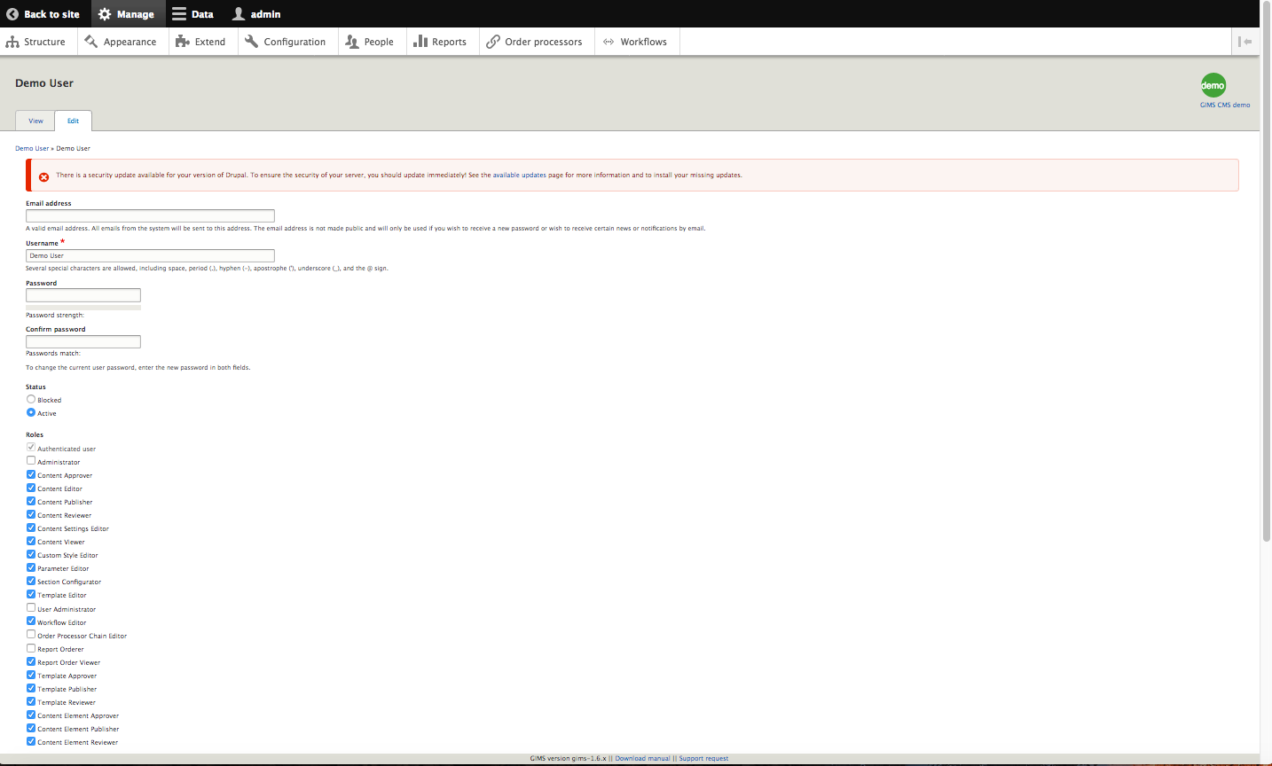
Comprehensive user management – roles and rights customizable

Slide 25
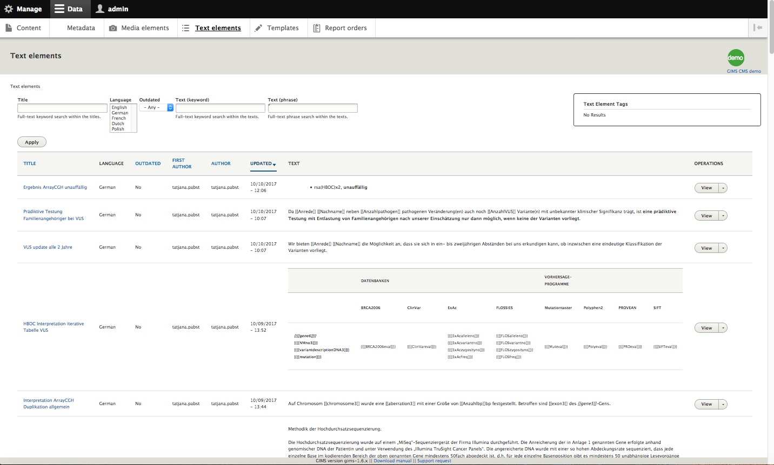
Full search for diagnostic content

Slide 26
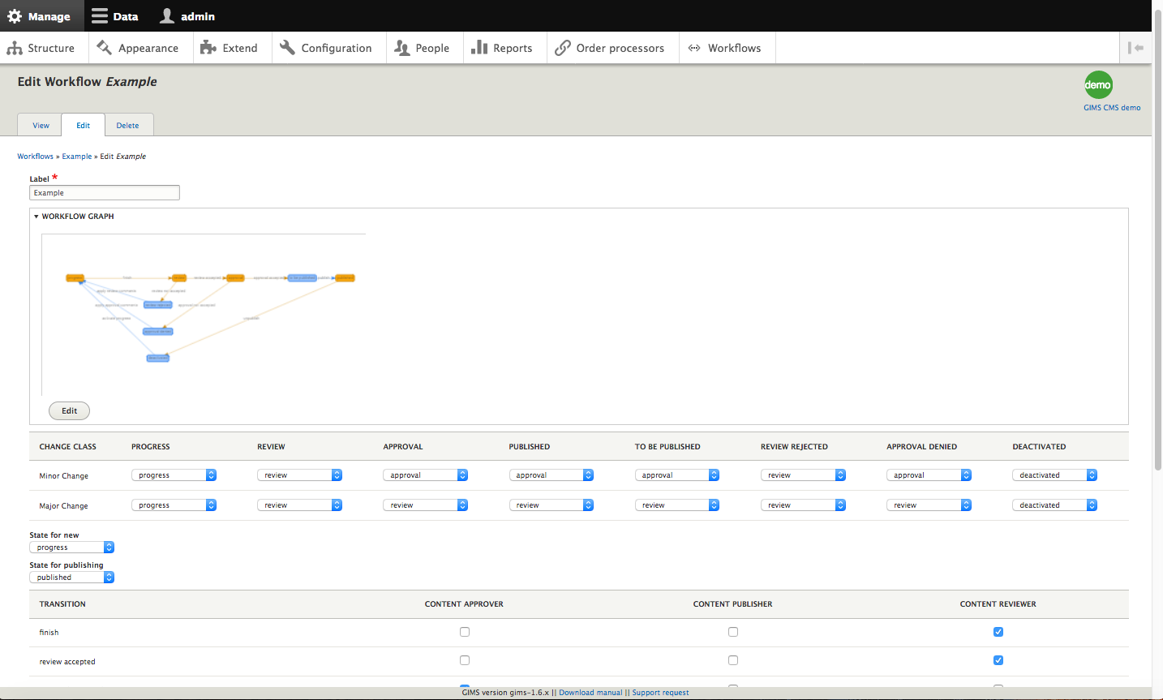
Freely definable workflows for editing, review, publishing, etc.

Slide 27
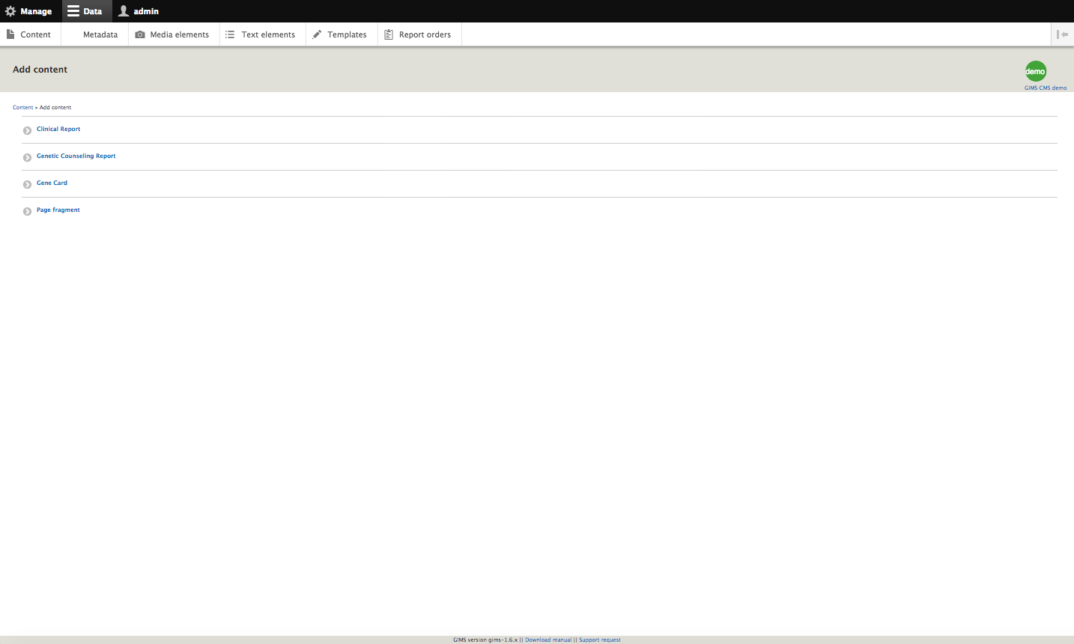
Customizable document templates for clinical reports, physician letters, etc.

Slide 28
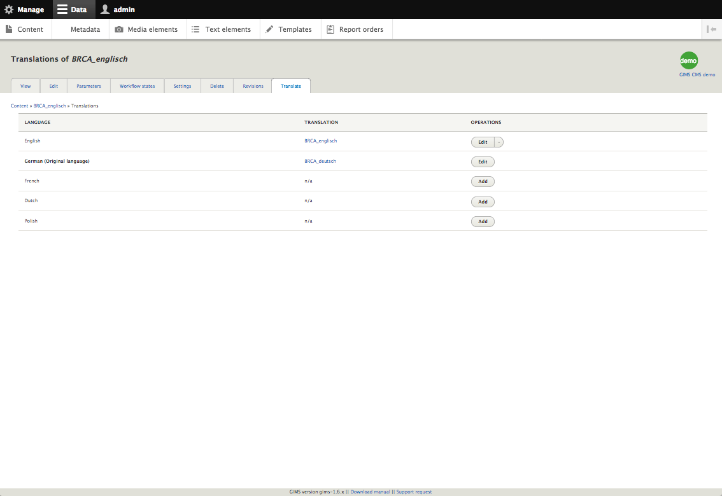
Translation functionalities

Slide 29
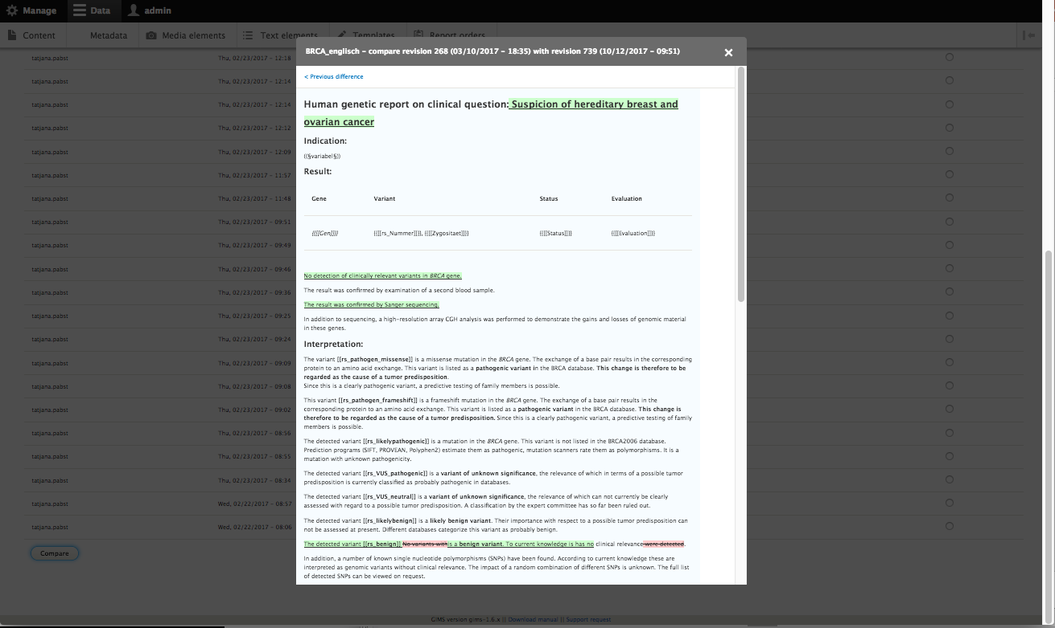
Traceability of revisions

Slide 30
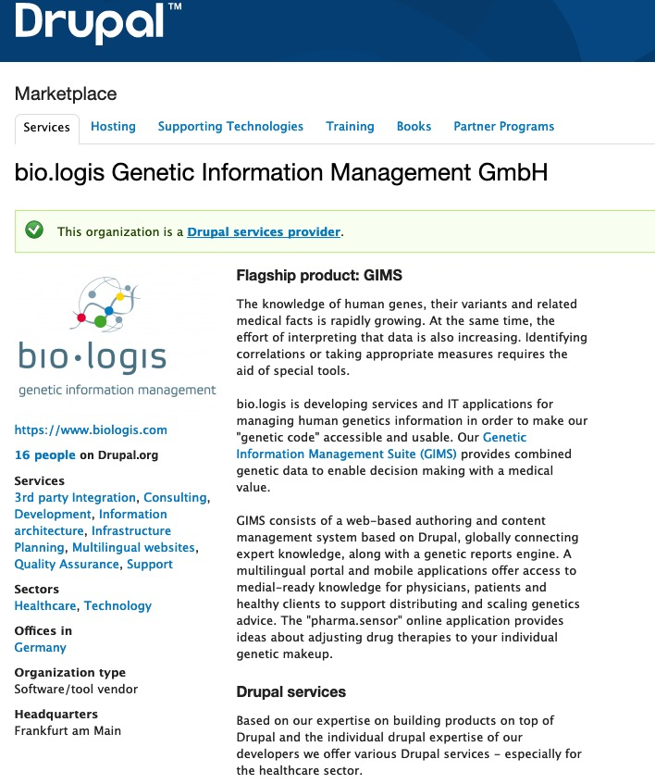
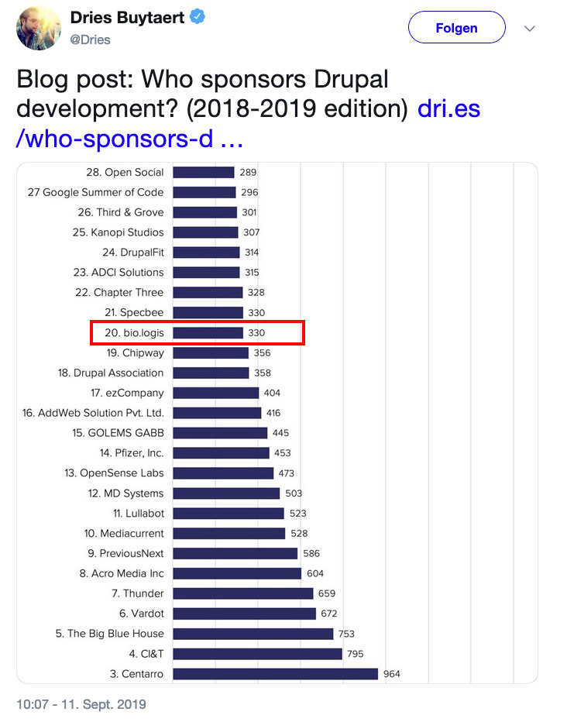
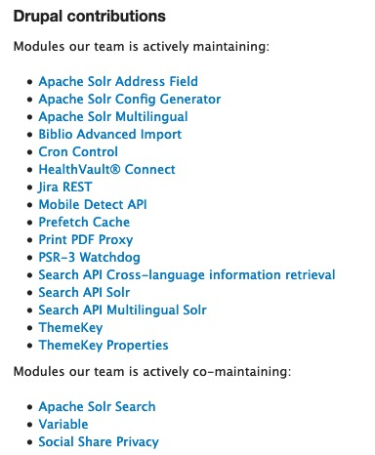
Contribution to Drupal

Slide 31
Join us for
contribution opportunities
Thursday, October 31, 2019
Mentored
Contribution
First Time
Contributor Workshop
General
Contribution
9:00-18:00
Room: Europe Foyer 2
9:00-14:00
Room: Diamond Lounge
9:00-18:00
Room: Europe Foyer 2
#DrupalContributions

Slide 32

What did you think?
Locate this session at the DrupalCon Seattle website:
https://drupal.kuoni-congress.info/2019/program/
Take the Survey!
https://www.surveymonkey.com/r/DrupalConAmsterdam

